Slide 1
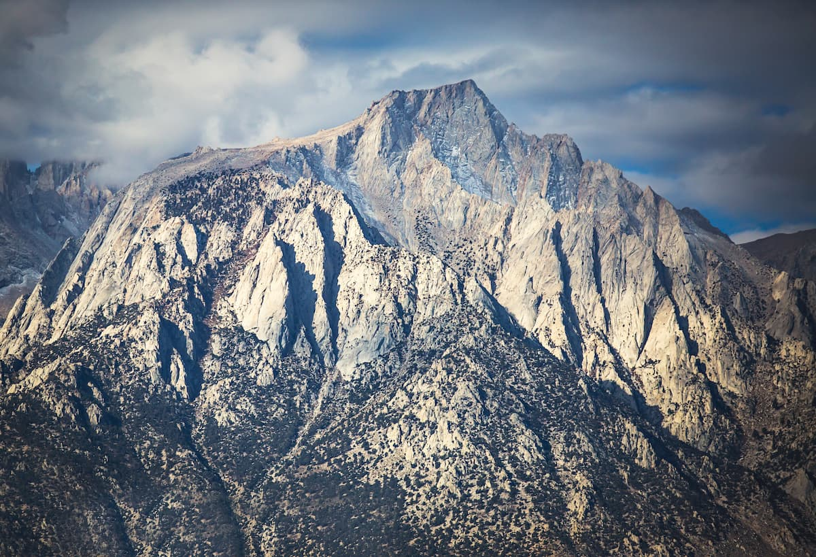
Exhumation Of The Inyo Mountains
Lee et. al. 2009
Ryan Parkyn

Slide 2
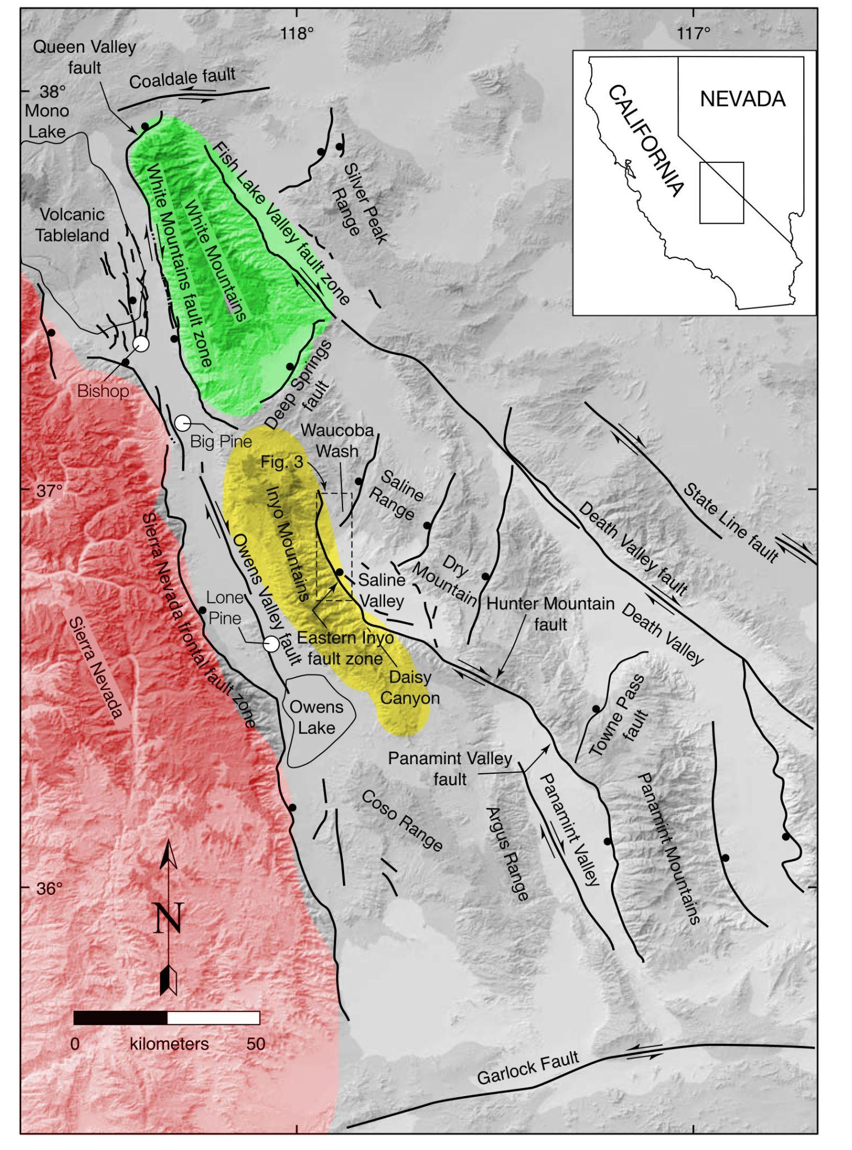
Where are the Inyo Mountains?
ECSZ
East Inyo Fault Zone (EIFZ)
Authors measured Hunter Mountain Fault

Slide 3
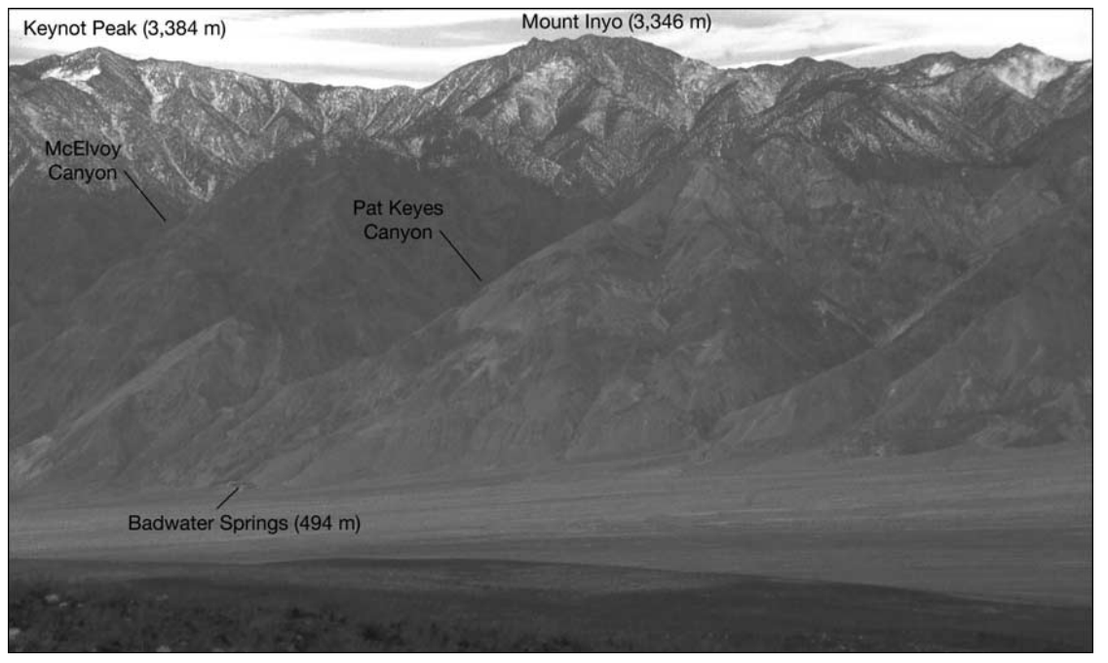
Triassic Pat Keys Pluton (~210Ma)
Basalt Lavas (Pliocene)
Paleozoic Metaseds (deformed late as Cretaceous)
Differentiated Quaternary
(<13.62 Ma)

Slide 4
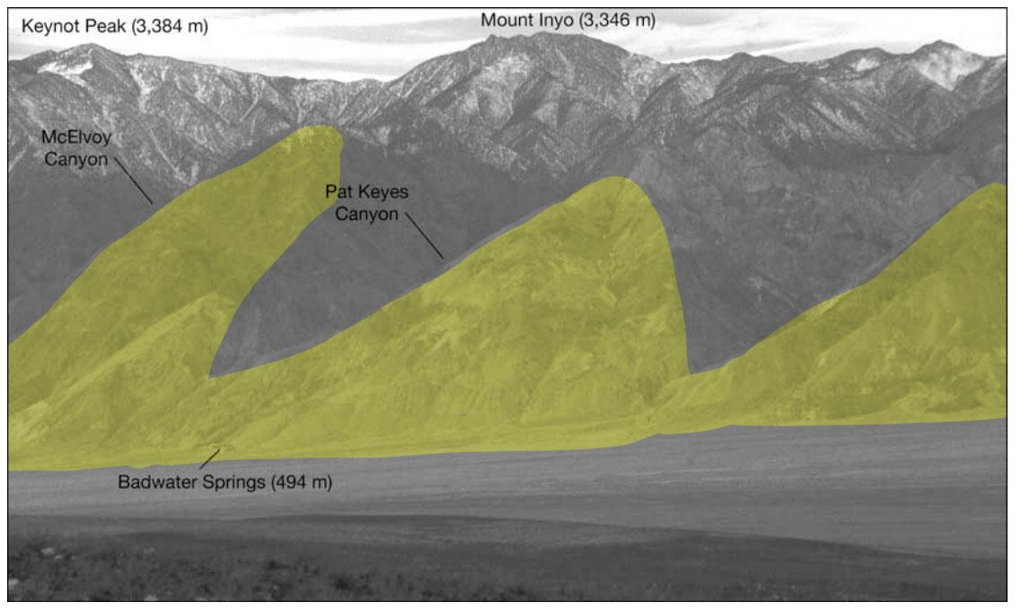
3km escarpment = Inyo Mountain = Footwall

Slide 5
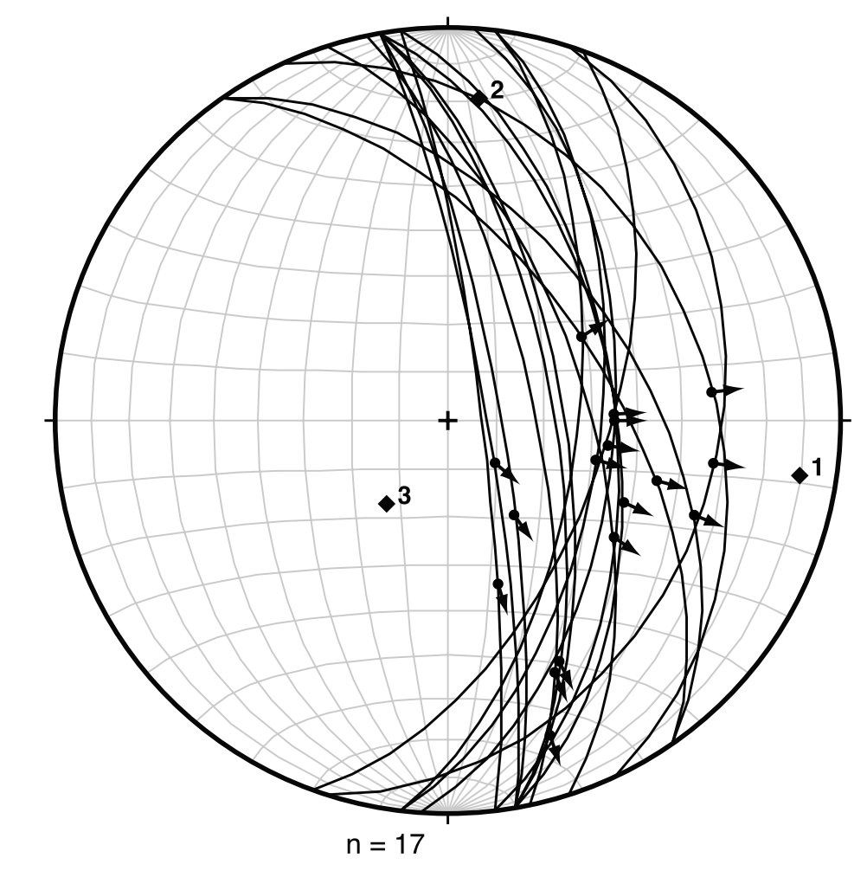
Lower Hemisphere Stereonet of East Inyo Fault Zone
Great circles = faults
Point with arrow = fault striations
1 = Extension axis (E-W)
2 = Intermediate axis
3 = shortening axis (nearly vertical)
Dominantly normal dip-slip, but dextral oblique
N
W
E
S

Slide 6
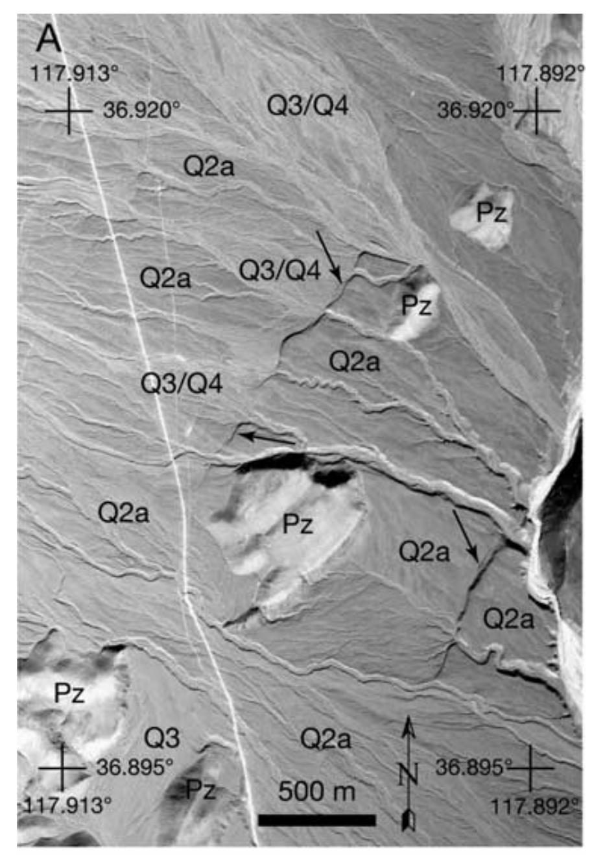
Q4 = active debris flow
(Youngest)
Q3 = Alluvial features inset into older features
(undated)
Q2a/b = old alluvium
Q2a Mean age = ~44.3ka (Cosmogenic),
Q2b = Mean age = ~17.7ka (Cosmogenic)
Hunter Mountains Slip Rate = 3.2+/- 1 mm/yr
Q1 = Oldest Q, well consolidated
Pz = Paleozoic metased. Bedrock (oldest)
Aerial Mapping and Cosmogenic Dates

Slide 7
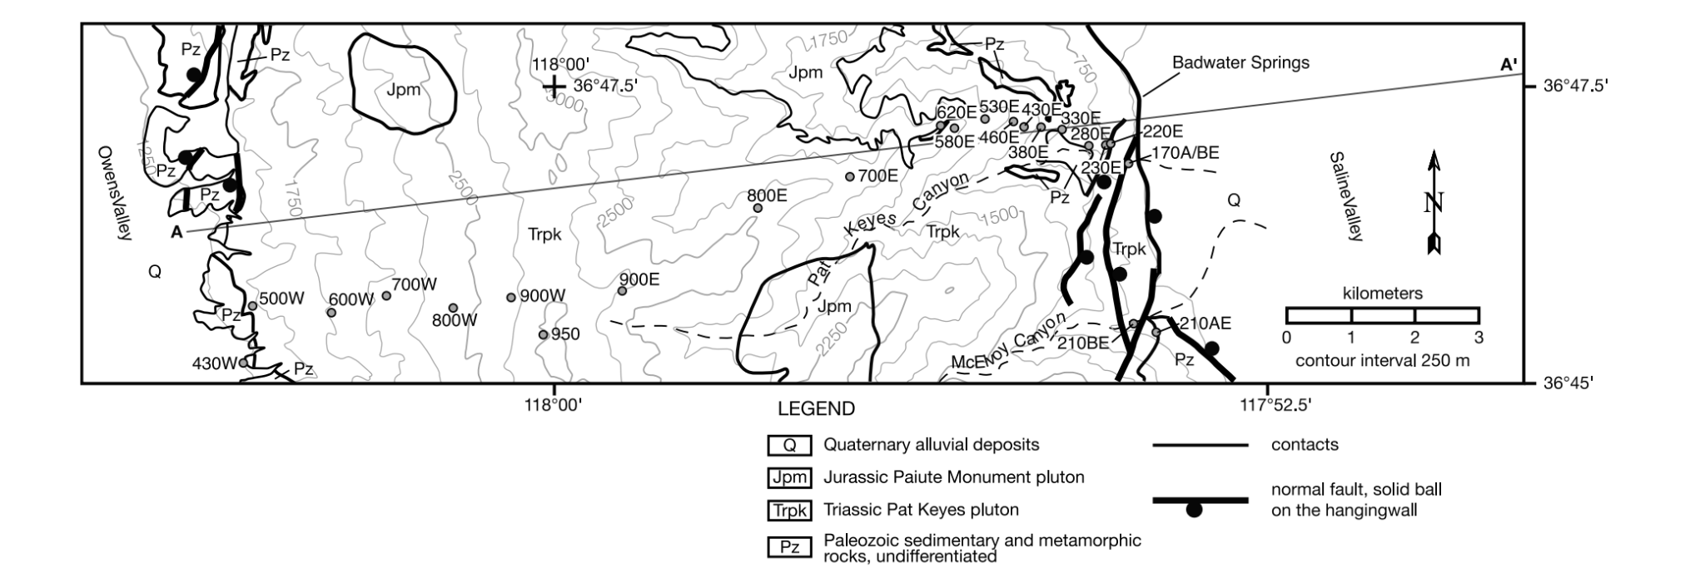
Simplified topographic + geologic map showing units, faults, X-section, thermochron sample locations

Slide 8
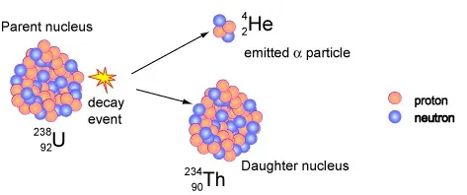
Inyo Mountains Zircon U-Th/He Ages Projected on A-A’
Zircon U-Th/He closure temperature = ~185C
Shows the age (Ma) in which zircon crystalized enough to accumulate He

Slide 9
Inyo Mountains Apatite U-Th/He Ages Projected on A-A’
Apatite U-Th/He closure temperature = ~70C
Shows the age (Ma) in which apatite crystalized enough to accumulate He

Slide 10
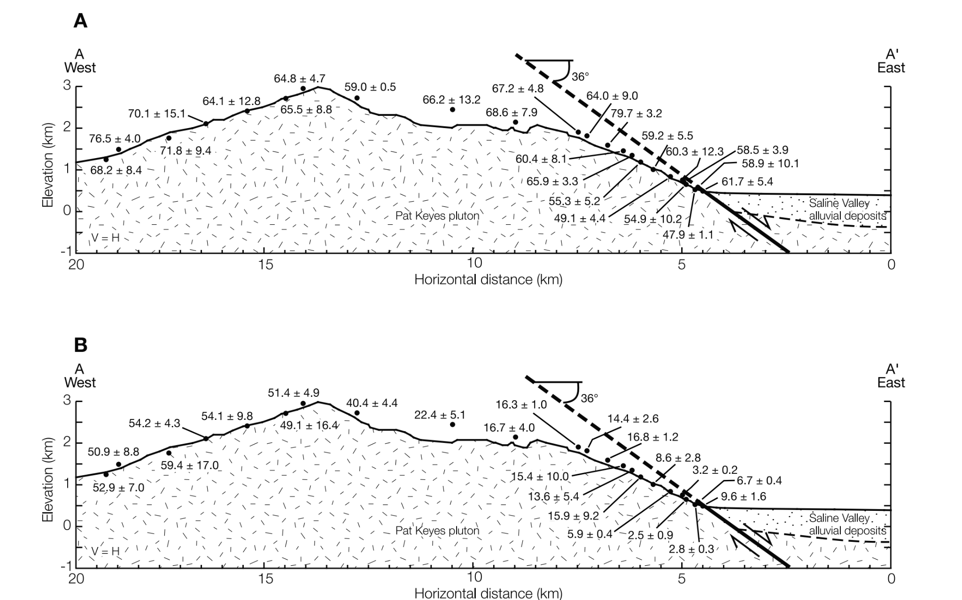
Zircon = ~185C
Apatite = ~70

Slide 11
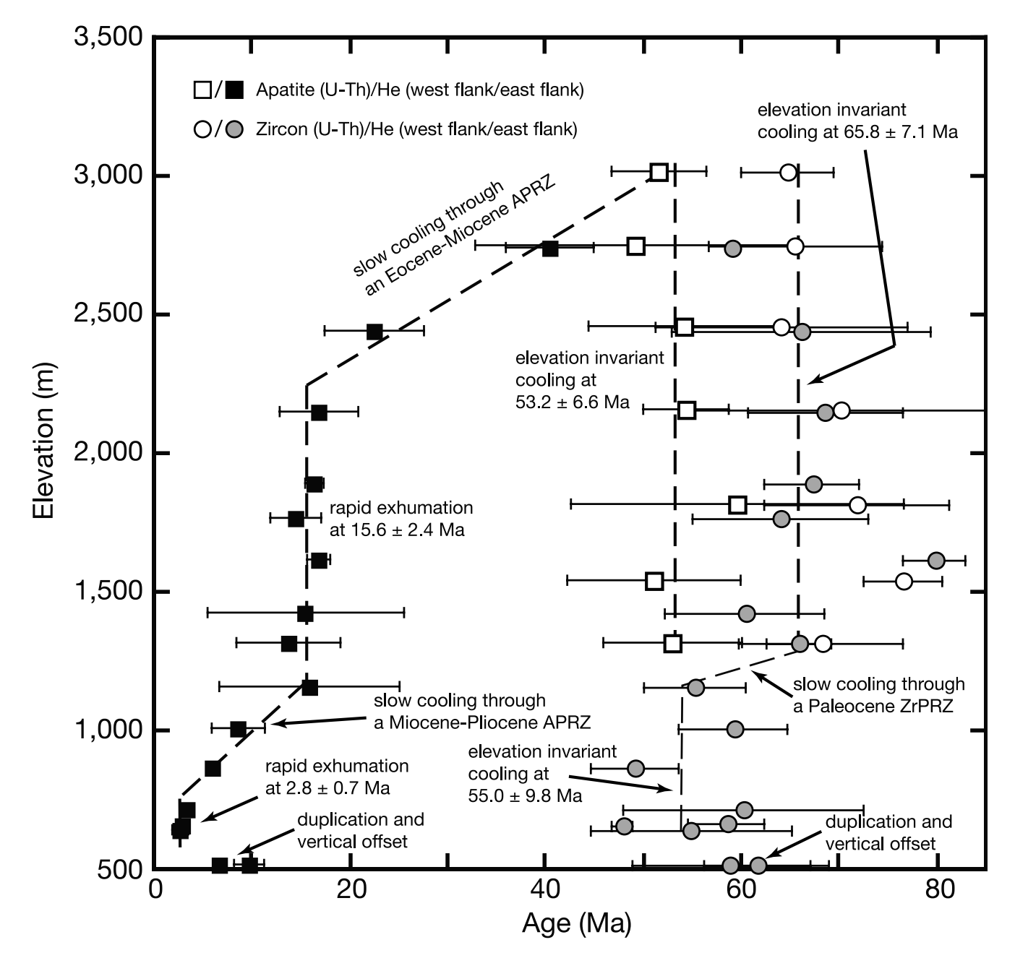
Exhumation Story
Square = Apatite, crystallizes last
Circle = Zircon, crystallizes first
White = west flank
Black/gray = east flank
Read right to left, top to bottom
Time-elevation path
Steep slope = fast exhumation
East flank cooled differently than west
Western Flank - zircon and apatite cooled at ~60Ma
Eastern Flank - Exhumed rocks have a younger age with time because they were deeper

Slide 12
Exhumation Story
Zircon = Near uniform cooling rate
Apatite = two periods of cooling, exhumation, and normal slip (coincident)
Normal slip = 15.6 Ma, not lasting more than 1.5 Ma based on cosmogenic Qa seds (>13.62 Ma)
2nd episode of normal slip = 2.8 Ma, cut pleistocene alluvial surfaces (indicate active)

Slide 13
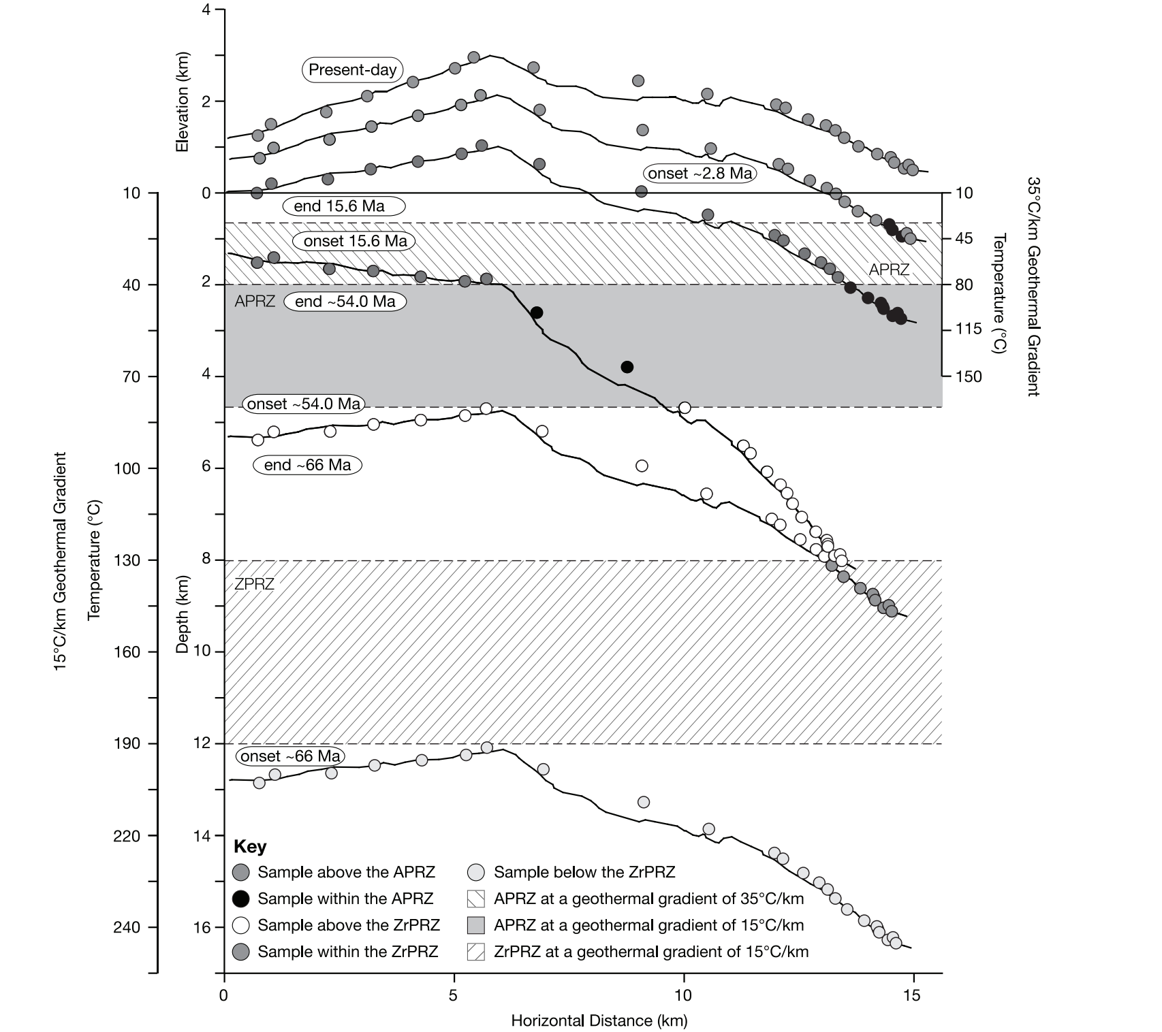

Slide 14
U/Th-He Zircon & Apatite exhumation ages show exhumation rotation of eastern Inyos in two slip events at 15.6 and 2.8, cosmogenic dates of alluvium shows normal faulting still active
U/Th-He Ages of Apatite and Zircon:
Zircon: Pat Keys Pluton (Inyos) cooled homogeneously
Apatite: West side of Inyos was exhumed first (50-20Ma), while east side lagged and was rotated cooling at a later time (Between ~16Ma and 2.8Ma)
Moderate-rapid exhumation related to Laramide deformation
2 episodes of normal slip along IMFZ footwall -> Normal slip led to cooling
1st: 15.6Ma (lasted ~1.5Ma)
2nd: 2.8Ma (Presently active)
Cosmogenically dated alluvium shows at least two recent uplift events, EIFZ still active

